Slide 1
Vehicle Testing System
Remark
Objective: Simulate testing scenarios for vehicles, such as load capacity, terrain handling, and durability. Features: • Test vehicles under various load and terrain conditions. • Generate performance reports with pass/fail metrics. • Suggest improvements based on test results. OOP Concepts Used: • Encapsulation: Classes like Vehicle, TestScenario, and TestResult encapsulate related attributes and behaviors. • Inheritance: Extend TestScenario into specific tests like LoadTest, TerrainTest, and DurabilityTest. • Polymorphism: Implement different testing methods for various vehicle types. Possible Extensions: • Add machine learning for predictive testing. • Include a database to store historical test data.

Slide 2
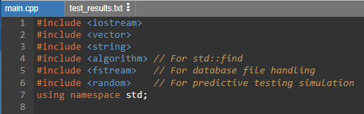
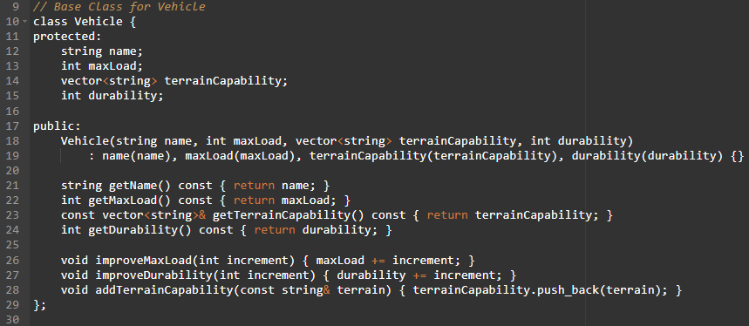
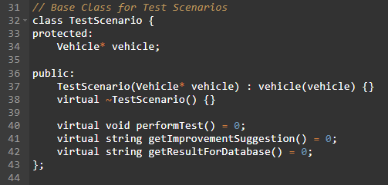
Code Explanation
These libraries provide essential functionalities:
- `iostream` for input/output operations.
- `vector` for handling dynamic arrays.
- `string` for string manipulation.
- `algorithm` for algorithms like `std::find`.
- `fstream` for file handling.
- `random` for generating random numbers.
This class represents a vehicle with attributes:
- `name`: The name of the vehicle.
- `maxLoad`: The maximum load the vehicle can handle.
- `terrainCapability`: The types of terrain the vehicle can handle.
- `durability`: The durability rating of the vehicle.
The class also includes methods to get these attributes and improve them:
- `improveMaxLoad(int increment)`: Increases the maximum load capacity.
- `improveDurability(int increment)`: Increases the durability rating.
- `addTerrainCapability(const string& terrain)`: Adds a new terrain capability.
This is an abstract base class for different test scenarios. It contains:
- A pointer to a `Vehicle` object.
- Pure virtual functions for performing tests, getting improvement suggestions, and getting results for the database.

Slide 3
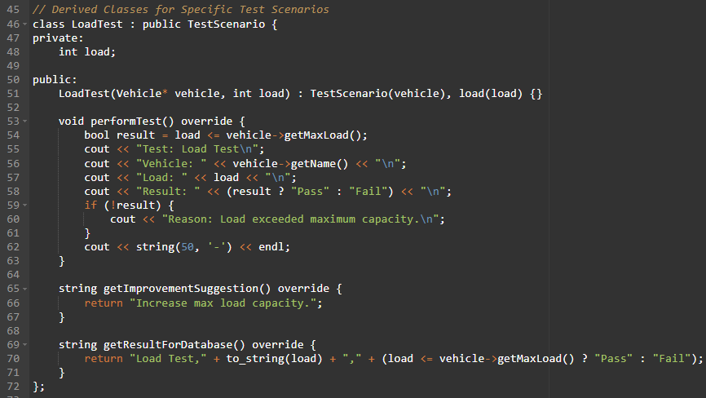
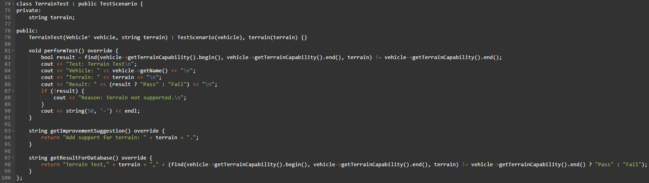
This class tests if the vehicle can handle a specified load. It includes:
- `load`: The load to be tested.
- `performTest()`: Performs the load test and prints the result.
- `getImprovementSuggestion()`: Suggests increasing the max load capacity if the test fails.
- `getResultForDatabase()`: Returns the test result formatted for database storage.
This class tests if the vehicle can handle a specified terrain. It includes:
- `terrain`: The terrain to be tested.
- `performTest()`: Performs the terrain test and prints the result.
- `getImprovementSuggestion()`: Suggests adding support for the terrain if the test fails.
- `getResultForDatabase()`: Returns the test result formatted for database storage.

Slide 4
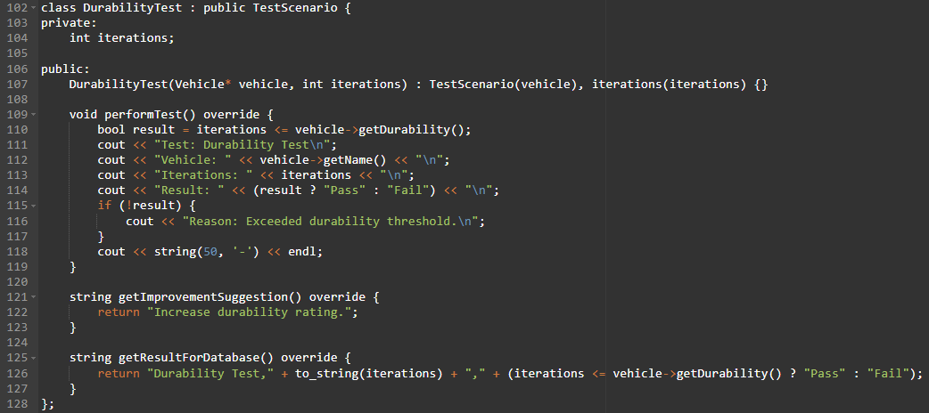
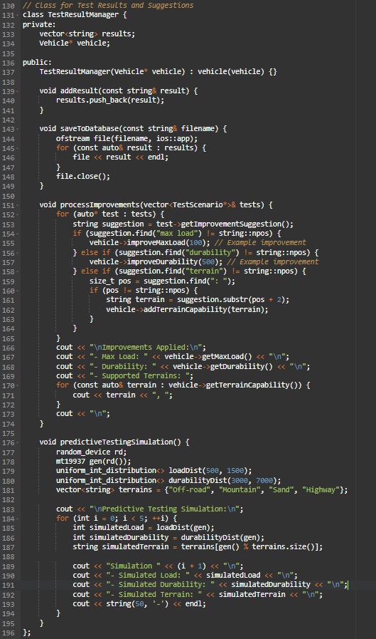
This class tests if the vehicle can handle a specified number of iterations. It includes:
- `iterations`: The number of iterations to be tested.
- `performTest()`: Performs the durability test and prints the result.
- `getImprovementSuggestion()`: Suggests increasing the durability rating if the test fails.
- `getResultForDatabase()`: Returns the test result formatted for database storage.
Class: `TestResultManager`
- Private Members:
- `vector<string> results`: Stores the test results.
- `Vehicle* vehicle`: Pointer to a `Vehicle` object.
- Public Methods:
- Constructor: Initializes the `vehicle` pointer.
- `addResult(const string& result)`: Adds a test result to the `results` vector.
- `saveToDatabase(const string& filename)`: Saves the test results to a file.
- `processImprovements(vector<TestScenario*>& tests)`: Processes improvement suggestions from test scenarios and applies them to the vehicle.
- `predictiveTestingSimulation()`: Simulates predictive testing for the vehicle.
Method Details:
- `addResult(const string& result)`:
- Adds a test result to the `results` vector.
- `saveToDatabase(const string& filename)`:
- Opens a file in append mode.
- Writes each result from the `results` vector to the file.
- Closes the file.
- `processImprovements(vector<TestScenario*>& tests)`:
- Iterates through each test scenario.
- Retrieves improvement suggestions and applies them to the vehicle:
- If the suggestion mentions "max load", it improves the vehicle's max load.
- If the suggestion mentions "durability", it improves the vehicle's durability.
- If the suggestion mentions "terrain", it adds the specified terrain capability to the vehicle.
- Prints the applied improvements.
- `predictiveTestingSimulation()`:
- Simulates predictive testing by generating random values for load, durability, and terrain.
- Prints the simulated values for five simulations.

Slide 5
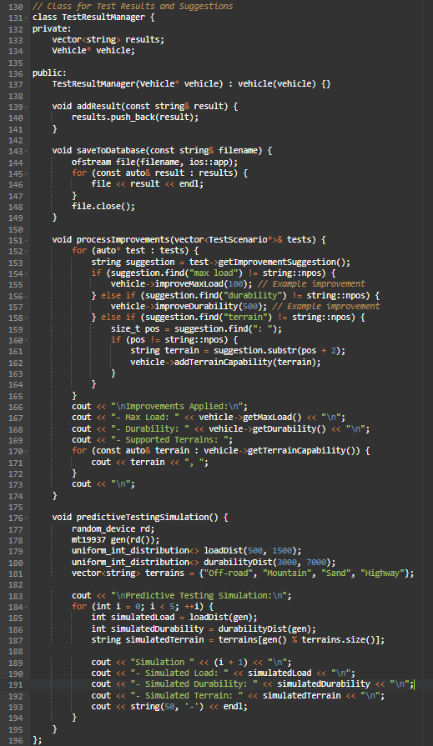
Class: `TestResultManager`
- Private Members:
- `vector<string> results`: Stores the test results.
- `Vehicle* vehicle`: Pointer to a `Vehicle` object.
- Public Methods:
- Constructor: Initializes the `vehicle` pointer.
- `addResult(const string& result)`: Adds a test result to the `results` vector.
- `saveToDatabase(const string& filename)`: Saves the test results to a file.
- `processImprovements(vector<TestScenario*>& tests)`: Processes improvement suggestions from test scenarios and applies them to the vehicle.
- `predictiveTestingSimulation()`: Simulates predictive testing for the vehicle.
Method Details:
- `addResult(const string& result)`:
- Adds a test result to the `results` vector.
- `saveToDatabase(const string& filename)`:
- Opens a file in append mode.
- Writes each result from the `results` vector to the file.
- Closes the file.
- `processImprovements(vector<TestScenario*>& tests)`:
- Iterates through each test scenario.
- Retrieves improvement suggestions and applies them to the vehicle:
- If the suggestion mentions "max load", it improves the vehicle's max load.
- If the suggestion mentions "durability", it improves the vehicle's durability.
- If the suggestion mentions "terrain", it adds the specified terrain capability to the vehicle.
- Prints the applied improvements.
- `predictiveTestingSimulation()`:
- Simulates predictive testing by generating random values for load, durability, and terrain.
- Prints the simulated values for five simulations.

Slide 6
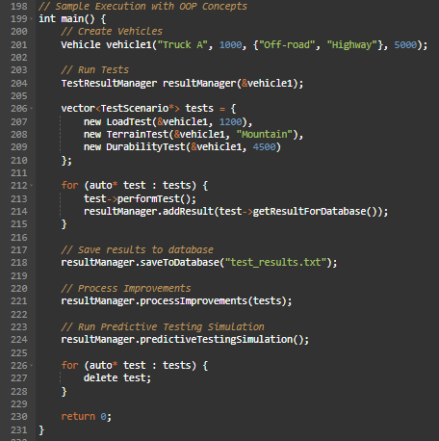
This is the main function where the program execution begins. It performs the following steps:
1. Create Vehicles:
Vehicle vehicle1("Truck A", 1000, {"Off-road", "Highway"}, 5000);
```
Creates a `Vehicle` object named "Truck A" with a maximum load of 1000 kg, capable of handling "Off-road" and "Highway" terrains, and a durability rating of 5000.
2. Run Tests:
TestResultManager resultManager(&vehicle1);
vector<TestScenario*> tests = {
new LoadTest(&vehicle1, 1200),
new TerrainTest(&vehicle1, "Mountain"),
new DurabilityTest(&vehicle1, 4500)
};
for (auto* test : tests) {
test->performTest();
resultManager.addResult(test->getResultForDatabase());
}
Creates a `TestResultManager` object to manage test results. It then creates a vector of `TestScenario` pointers, each pointing to a specific test (load, terrain, and durability). Each test is performed, and the results are added to the `TestResultManager`.
3. Save Results to Database:
resultManager.saveToDatabase("test_results.txt");
Saves the test results to a file named "test_results.txt".
4. Process Improvements:
resultManager.processImprovements(tests);
Processes improvement suggestions based on the test results and applies them to the vehicle.
5. Run Predictive Testing Simulation:
resultManager.predictiveTestingSimulation();
Runs a predictive testing simulation to generate random test scenarios and print the results.
6. Clean Up:
for (auto* test : tests) {
delete test;
}
Deletes the dynamically allocated test objects to free up memory.

Slide 7
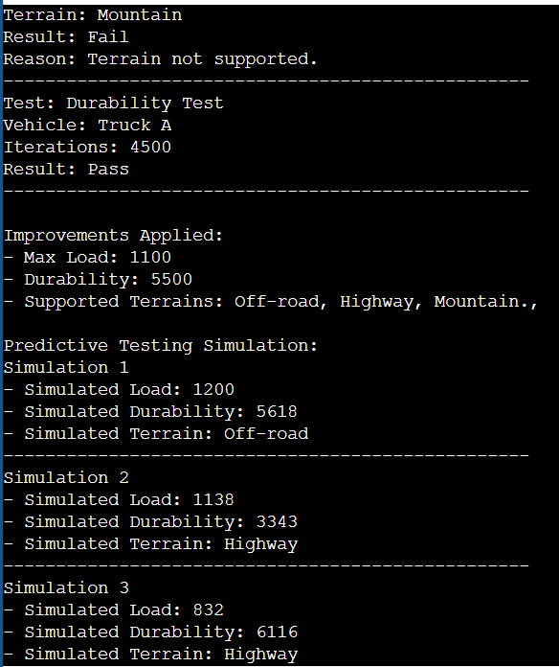
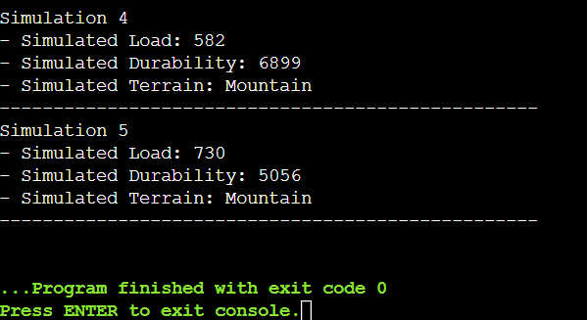
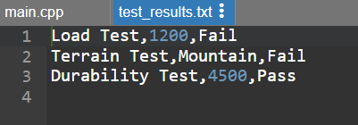
Output

Slide 8
THANK YOU

